Slide 1



AIRBNB NYC 2019
Team Members Names: B.ADITI
ESHA MALLIKA
G.SHRIYA
KANDLAKUNTA SRAVYA

Slide 2


Contents of the Presentation:
1.Overview
2.KPIs
3,4.Dashboard images
5.Insights
6.Thank you

Slide 3
OVERVIEW
AIRBNB IN NYC HAD A BUSTLING YEAR WITH NUMEROUS LISTINGS AND GUESTS.
BROOKLYN AND MANHATTAN WERE THE MOST POPULAR BOROUGHS FOR STAYS.
TOP NEIGHBOURHOOD INCLUDED WILLIAMSBURG, EAST VILLAGE AND HARLEM.
AVERAGE NIGHTLY PRICE WAS AROUND $150 VARYING BY ACCOMODOTION
HOSTS WERE WELCOMING, AND GUESTS HAD POSITIVE EXPERIENCES OVERALL
AIRBNB IN NYC OFFERED DIVERSE OPTIONS FOR TRAVELERS TO EXPLORE THE CITY VIBRANT CULTURE

Slide 4
KPI’S
AVERAGE OF PRICE = 152.71
AVERAGE PRICE PER NIGHT = 21.70
AVERAGE OF REVIEWS PER MONTH = 21.38
AVERAGE OF BUSY DAYS PER YEAR = 112.61
AVERAGE LISTINGS = 7.16
TOTAL RENTALS = 47,000
TOTAL ROOM TYPES = 4
TOTAL NEIGHBOURHOOD AREAS = 222
TOTAL LISTINGS = 37,000
AVERAGE AVALIABILITY = 113
TOTAL HOSTS = 11,000
TOTAL REVIEWS PER MONTH = 53,000
TOTAL CLASSIFICATION RENTALS = 5

Slide 5
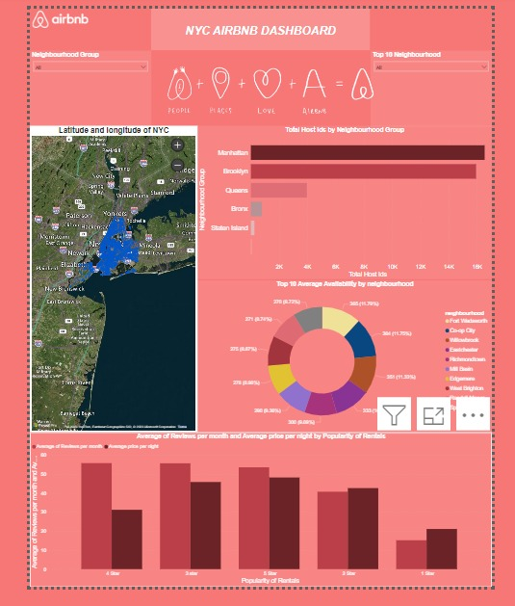

Slide 6
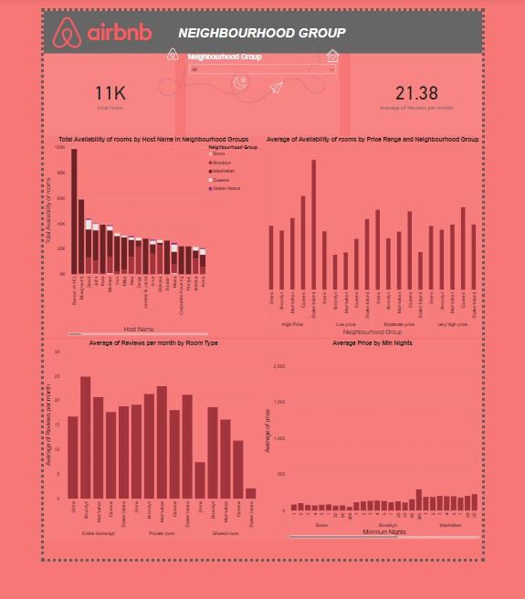

Slide 7
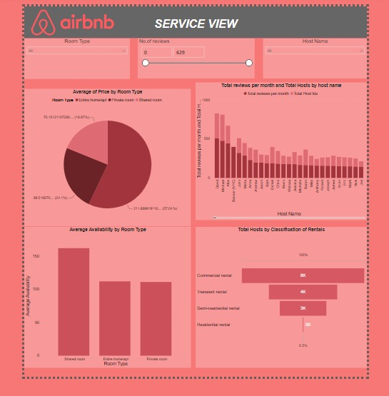

Slide 8
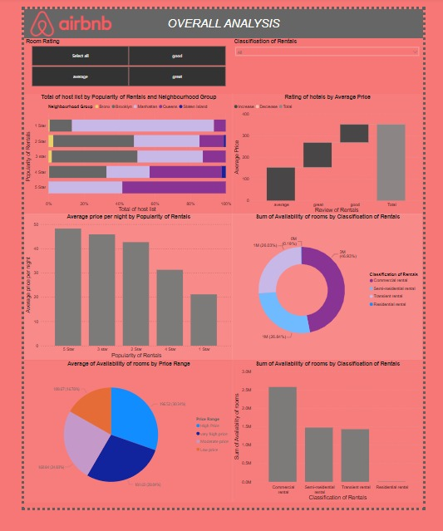

Slide 9
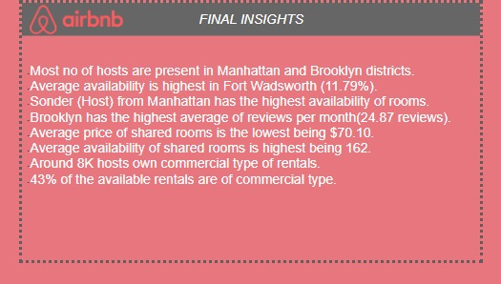
INSIGHTS

Slide 10
THANK YOU
K.SRAVYA - Github profile- Sravya20kandlakunta
Gmail Id- sravs.kandlakunta.1977@gmail.com
Linkedin profile- Sravya Kandlakunt
ESHA MALLIKA - Github profile - eshabvc
Gmail Id - eshaappaneni@gmail.com
Linkedin profile - esha appaneni
B.ADITI - Github profile- Aditi20003
Gmail Id- aditibule2003@gmail.com

